Slide 1
How to Approach Radiology Procedures
Jonathan G. Martin MD

Slide 2
What procedures do we perform?
Hepatobiliary
Transjugular intrahepatic portosystemic shunts, balloon occluded retrograde transvenous obliteration, biliary drainage, biliary stenting
Oncology
Biopsy, liver/kidney ablation, chemoembolization, selective internal radiotherapy, soft tissue tumor ablation, preoperative embolization
Women’s Health
Uterine artery embolization, placenta accrete/previa/increta embolization, fallopian tube recanalization
Men’s Health
Prostate artery embolization, pudendal nerve block
Palliation
Celiac plexus block, cryoneurolysis, phantom limb pain ablation, tunneled pleural/abdominal effusion catheter placement
Musculoskeletal
Vertebral body augmentation/kyphoplasty, desmoid tumor ablation, pre operative embolization
Venous
Venograms, venous access, catheters, ports, IVC filter placement/retrieval, dialysis catheters, fistulagram, deep venous thrombosis and pulmonary embolism treatment and lysis, varicose vein treatment, varicocele/pelvic congestion
Arterial
Peripheral arterial disease (claudication and critical limb ischemia), mesenteric angiography, renal artery embolization, renal angiogram/stenting, uterine artery embolization, visceral artery aneurysms, pseudoaneurysm treatment, subclavian artery stenting
Gastrointestinal
Gastrostomy, jejunostomy, bariatric embolization, gastrointestinal bleeding, abscess drainage
Genitourinary
Nephrostostomy, nephroureterostomy, ureteral stents, nephrolithiasis management, suprapubic catheters

Slide 3
What to know about the patient:
The Procedure
What procedure are they having, and why?
Have they had this procedure before?
If so, any complications, including over/undersedation, access issues, etc.
A review of prior reports and procedural imaging are invaluable
Review of associated relevant imaging is mandatory
Ultrasound, CT and/or MRI for vascular access
CT abdomen, MRI abdomen, or even lowest slices of a CT chest for gastrostomy placement
Ultrasound or CT for biliary or nephrostomy placement
Abscess drainage usually requires CT for thorough evaluation

Slide 4
What to know about the patient:
Procedure specific details
Percutaneous nephrostomy: is it unilateral or bilateral?
If unilateral, the side for intervention MUST BE MARKED
Venous access: have they had multiple prior catheters? Are certain veins known to be thrombosed, open or closed? What type of catheter do they need and why? Tunneled or not?
Are they now, or might they be in the future, a candidate for dialysis? If so, know that subclavian access must be avoided as it risks all future fistula creation in that extremity
ESRD: when was the last time they were dialyzed? Do they have a fistula or a graft (these are very different things)
A fistula is native artery to native vein
A graft includes an interposed segment of artificial material

Slide 5
What to know about the patient:
Current Clinical Status:
Where is the patient? (ICU, floor, outpatient)
What is their code status?
Are they consentable?
If not, next of kin, power of attorney, phone # should be entered in EMR
If patient has dementia, is continuing with the procedure appropriate?
Evidence demonstrates gastrostomy tube placement in dementia often results in more harm than benefit
Basics
Are they NPO?
2 hrs for clear liquids
6-8 hours for solid foods and non-clear liquids
Are there any infectious signs/symptoms
If they have blood cultures, have they been clear for 48-72 hrs
Vital signs? Improving, worsening, stable?
Severe HTN increases risk of bleeding
What is their ASA Score?

Slide 6
What to know about the patient:
Current Clinical Status:
ASA 1: A normal healthy patient
usually an outpatient coming for an elective procedure, such as Vascath in a Stem Cell Donor, or a healthy person presenting for a thyroid nodule biopsy
ASA 2: A patient with mild systemic disease
a very common outpatient, sometimes an inpatient. example is a person with cancer, otherwise well
ASA Score
ASA 3: patient with severe systemic disease
the most common for in IR. most inpatients. ANY patient with ESRD is AT LEAST an ASA 3
ASA 4: patient with severe systemic disease that is a constant threat to life
these are unstable inpatients that REQUIRE general anesthesia…too unstable for moderate sedation.
ASA 5: A moribund patient who is not expected to survive
usually trauma or on-call emergency

Slide 7
What to know about the patient:
Current Clinical Status:
Labs:
within 30 days is usually good enough
INR <1.5 (or sometimes <2.0 is ok)
Need a recent INR if using anticoagulants
Platelets >50
Serum Potassium (increased cardiac events)
GFR > 30 (Creatinine <2.0), especially if contrast is to be used
mounting evidence this may not matter
Chart Review
Medications:
Warfarin, Plavix, Aspirin 325mg held for 5 days
Heparin IV held for 2-4 hours
Dabigatran/Apixaban/etc held for: 24-48 hrs
Allergies:
Contrast, lidocaine, opioids, versed, antibiotics, latex, nickel
Make sure to note degree of reaction
Anaphylaxis to anything

Slide 8
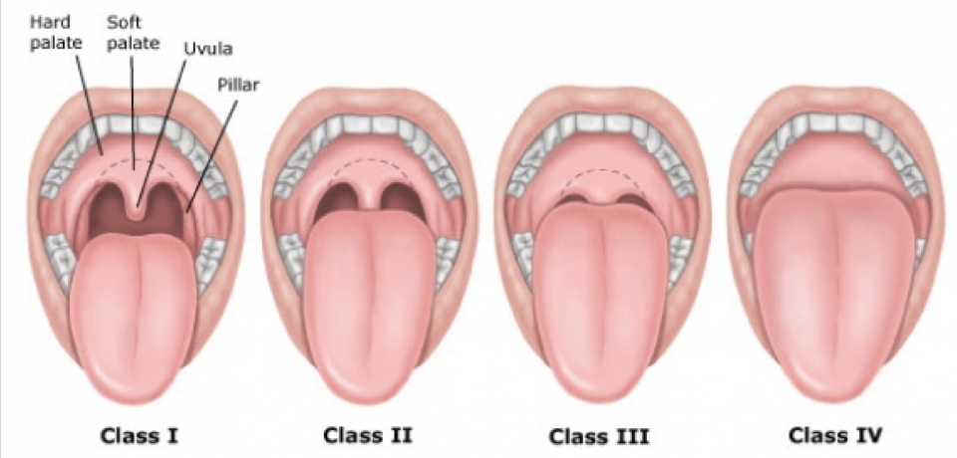
What to know about the patient:
Physical Exam
General disposition:
Cardiopulmonary reserve / oxygen requirements? Are they on respiratory support?
Can the patient lay flat / tolerate the procedure?
Are they “of size” (= very large)
What access / IVs do they currently have?
Airway:
Do they use CPAP, BiPAP, or have COPD
Any limitation to neck mobility, unusually thick neck?
Recent head and neck surgery?
What is their Mallampati Score?
Mallampati:
Class I
Soft palate, fauces, uvula, anterior and posterior pillars
Class II
Soft palate, fauces, uvula
Class III
Soft palate and BASE of uvula
Class IV
Soft palate not seen

Slide 9
Pain Management:
Moderate Sedation
IV Drugs: Most commonly Fentanyl and Versed
Common starting dose 1 mg Versed, 50 mcg Fentanyl
Higher tolerance may require Dilaudid (dose ~1 mg)
Allergies may suggest use of Morphine (dose ~2 mg)
If opioid induced itching -> Benadryl (25-50 mg)
Benadryl administration correlates with oversedation so it should not be used routinely
Nausea most commonly treated with Zofran
Local anesthesia: Lidocaine +/- sodium bicarbonate
Either way, the patient WILL feel it

Slide 10
Pain Management:
Oversedation
Reversal of opioids with Naloxone (Narcan)
Reversal of benzodiazepines with Flumazenil (Romazicon)
Adverse
Mild urticaria
Bronchospasm
Laryngeal edema
Hypotension with tachycardia
Hypotension with bradycardia
Severe hypertension
Seizures
Pulmonary edema
Reactions
Diphenhydramine 25-50 mg IV or PO
Albuterol inhaler +/- epinephrine
Epinephrine IV or IM*
Elevate legs, fluid bolus, +/- epinephrine
Elevate legs, fluid bolus, +/- atropine
Nitroglycerine 0.4 mg sublingual +/- labetalol
Valium 5 mg IV or Versed 1 mg IV
Lasix 20-40 mg IV +/- morphine
*Epinephrine SC or IM (1:1,000) 0.1 to 0.3 ml (0.1 to 0.3 mg) or, especially if hypotension evident, (1:10,000) slowly IV 1 to 3 ml (0.1 to 0.3 mg). ***EPI PEN***

Slide 11
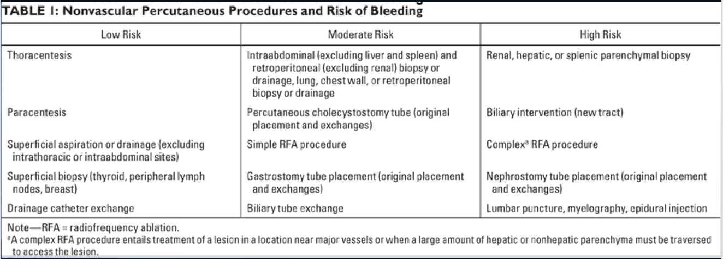
Procedural Risks:
Infection, bleeding, injury to adjacent structures
Antibiotic coverage:
Not universal around the world, in the USA, or likely even within your department
Coverage is based on area from which bugs would enter bloodstream
(percutaneous = skin, biliary = enteric, etc)
Risk of bleeding: see chart →
Special cases:
kidneys higher risk of uncontrolled bleeding
gastrostomy tube higher risk of peritonitis
embolization of solid organs (fibroid embolization, kidney, liver, spleen, etc) causes a post-embolization syndrome (flu-like symptoms for 1-2 weeks post procedure)
traumatic spleen embolization needs weeks of antibiotics and possible vaccination
Jaffe TA, Raiff D, Ho LM, Kim CY. Management of Anticoagulant and Antiplatelet Medications in Adults Undergoing Percutaneous Interventions. AJR Am J Roentgenol. 2015 Aug;205(2):421-8. doi: 10.2214/AJR.14.13342.

Slide 12
Post Procedure Care:
Vascular access (ports, permcaths, PICCs, etc) placed in IR are ready for immediate use
Femoral arterial access requires
*4-6 hours leg straight if manual compression utilized
*2 hours leg straight if closure device is used
Radial arterial access compressive band remains in place ~1 hr
Gastrostomy tube will generally have one of these two approaches:
Challenge in 2-4 hours, may eat overnight
Challenge in 24 hours, NPO overnight
Moderate sedation patient should be stable for 1 hour prior to discharge

Slide 13
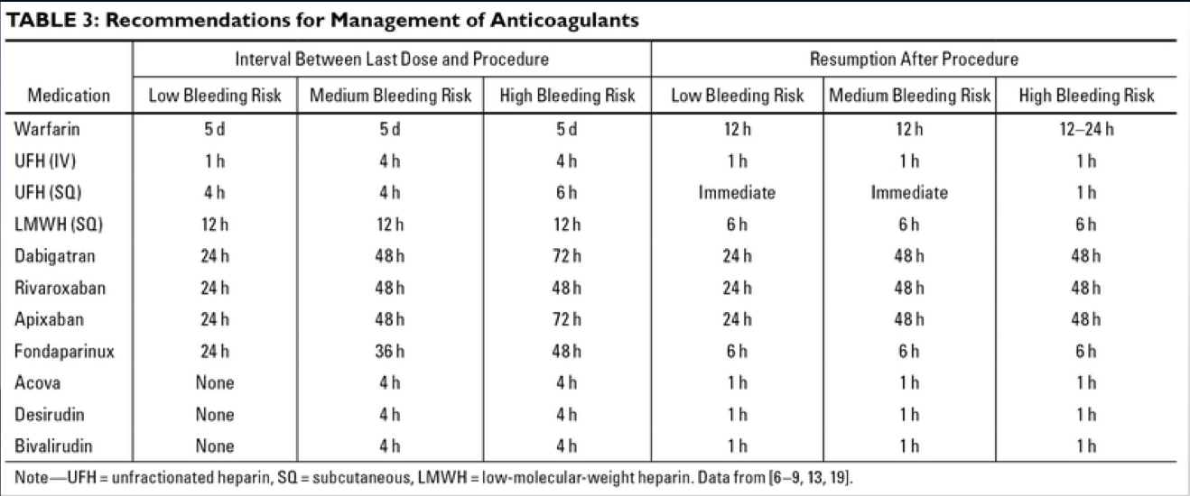
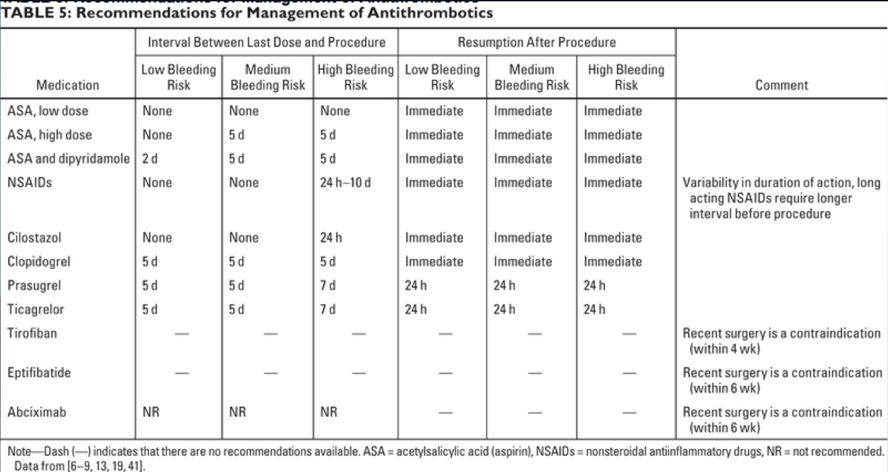
Post Procedure Care:
Resumption of anticoagulants →
← Resumption of antithrombotics
Jaffe TA, Raiff D, Ho LM, Kim CY. Management of Anticoagulant and Antiplatelet Medications in Adults Undergoing Percutaneous Interventions. AJR Am J Roentgenol. 2015 Aug;205(2):421-8. doi: 10.2214/AJR.14.13342.

